Slide 1


Slide 2




Slide 3


HELICAL

Slide 4



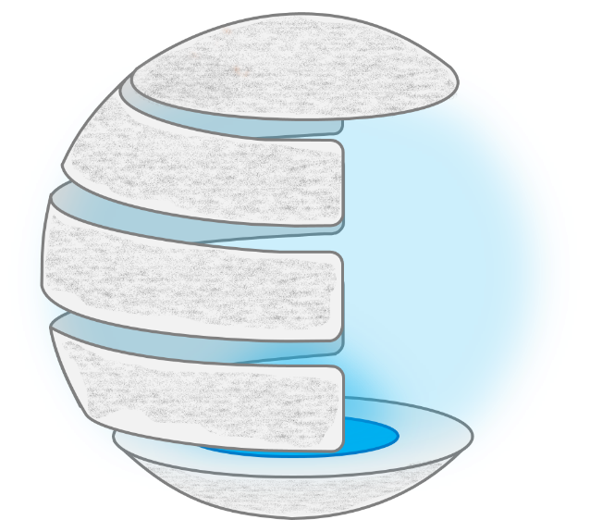








Slide 5
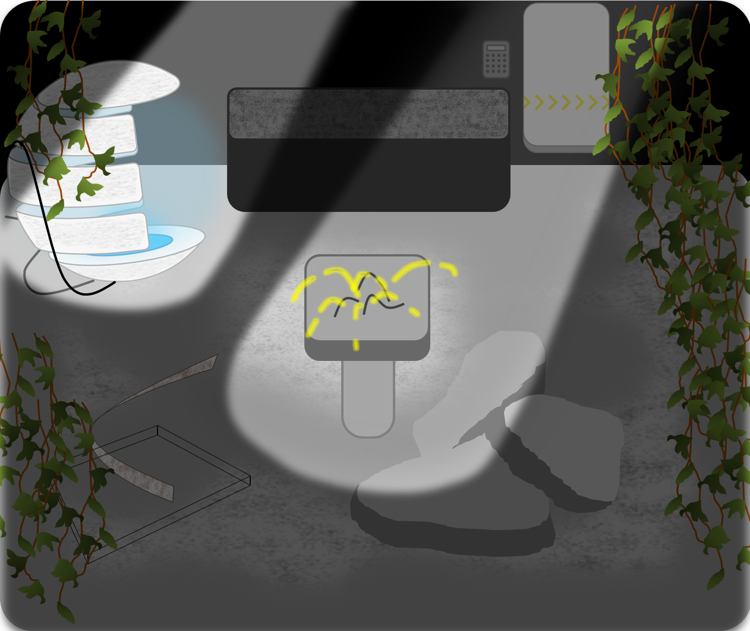

Slide 6


Slide 8
